Slide 1
Staged Self-Assembly and Polyomino Context-Free Grammars
Andrew Winslow
Defense Edition

Slide 2
Self-Assembly
Simple particles coalescing into
complex superstructures.

Slide 3
Self-Assembly
Simple particles coalescing into
complex superstructures.

Slide 4
Self-Assembly
Simple particles coalescing into
complex superstructures.

Slide 5
Self-Assembly
Simple particles coalescing into
complex superstructures.

Slide 6
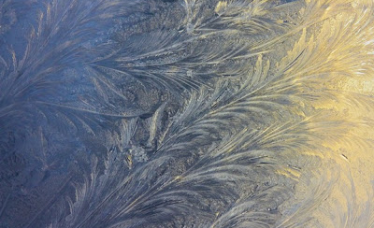
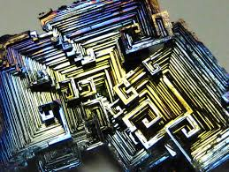
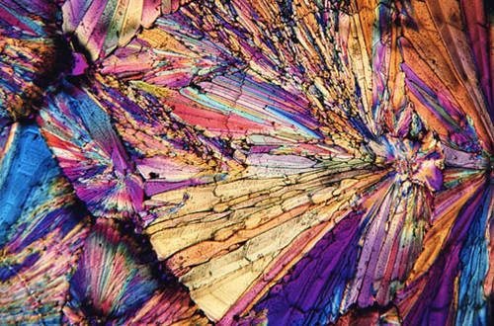
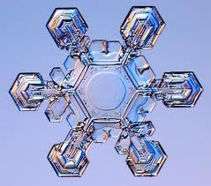
Crystallization
Notes:
Very simple particles, ubiqutous

Slide 7
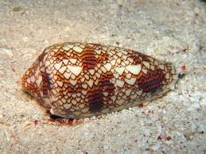
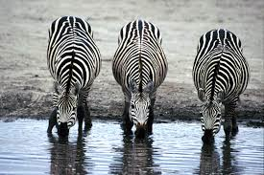
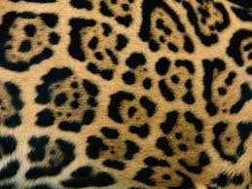
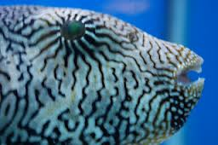
Morphogenesis
Notes:
Can produce highly intricate structures that are randomly sampled from a special, complex distribution

Slide 8
Natural Self-Assembly

Slide 9
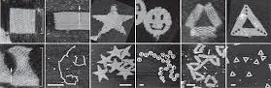
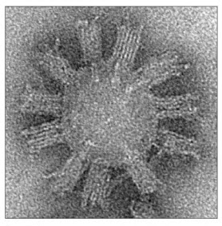
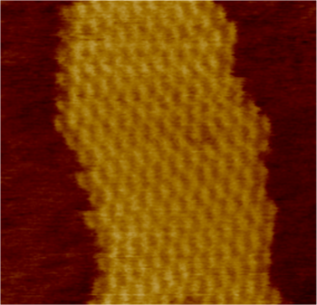
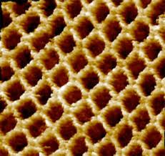
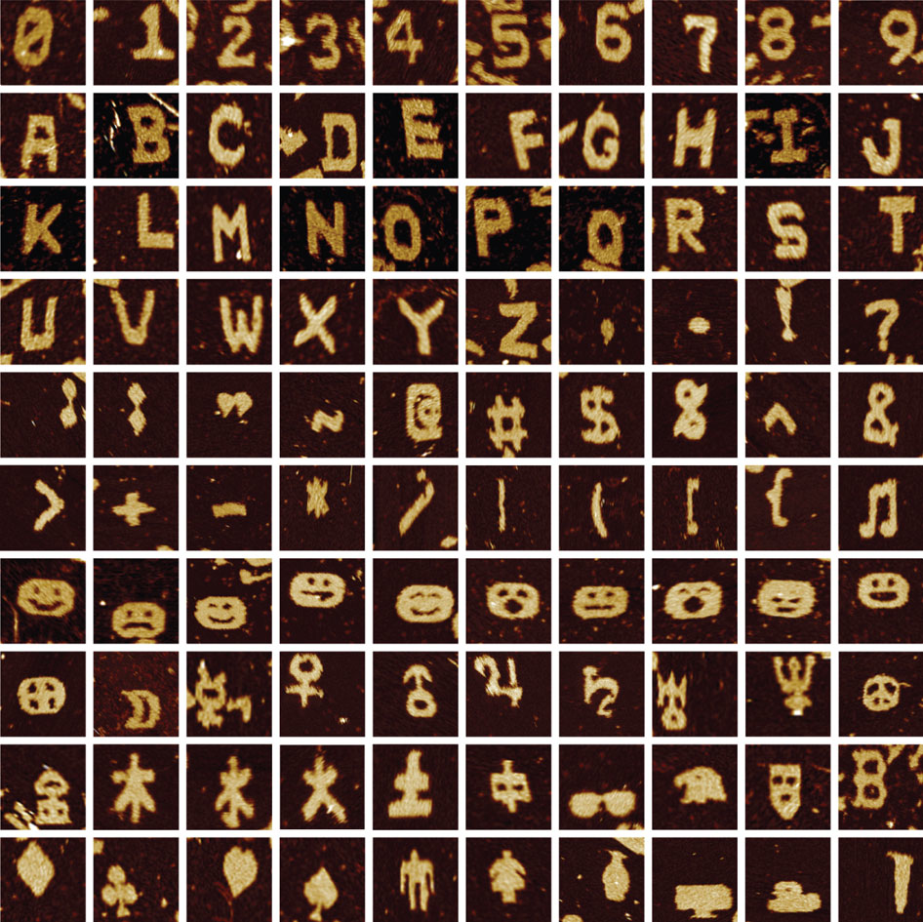
Synthetic Self-Assembly with DNA
Notes:
Variety of proof-of-concept shapes possible. Nanoscale (applications to build things smaller than otherwise possible). DNA is information-rich (more varied behavior in self-assembly).

Slide 11
Tile

Slide 12
Glues

Slide 15
Our work:
Study an abstract self-assembly model
based on DNA tile systems.

Slide 16
Tile

Slide 17
Glues

Slide 18
Assembly

Slide 19
Mixing
Notes:
We get everything resulting from tiles attaching in ANY ORDER, including forming separate assemblies that then combine.

Slide 20
Bin

Slide 21
Reagents

Slide 22
Products

Slide 24
Size

Slide 26
Staged self-assembly

Slide 27
Input
Output
(polyomino)
(small staged assembly system)

Slide 28
Input
n

Slide 32
Θ(n) system size

Slide 34
Θ(log(n)) system size

Slide 35
n
Θ(n)
Θ(log(n))

Slide 36
Input

Slide 37
Finding small systems is (NP-)hard.
Study a simplified model.

Slide 39
Rule

Slide 40
Grammar

Slide 41
One dimension
Ο(1)
? ? ?
? ? ?
Ο(#glues²)
Ω(n^{1/2}/log(n)), Ο(n^{2/3})
Grammar
Staged System
E. D. Demaine, S. Eisenstat, M. Ishaque, A. Winslow, One-dimensional staged self-assembly, DNA 17, 2011.

Slide 42
? ? ? ?

Slide 43
Polyomino Grammar

Slide 44
Two dimensions
Ο(log(n))
w/scaling
…
Macrotile
…
Ω(n/log³n)
Grammar
Staged System
A. Winslow, Staged Self-Assembly and Polyomino Context-Free Grammars, DNA 19, 2013.

Slide 45
?
?
?
?
?
?

Slide 46
Values

Slide 47
Values are distinct
Values are contiguous

Slide 48
Activation

Slide 49
Activation

Slide 52
? ? ?

Slide 53
? ? ?

Slide 54
? ? ?

Slide 55
[1..3] +4
Shifting

Slide 56
[4..6] +4
Shifting

Slide 57
[1..3] +4
Activation
Shifting

Slide 58
? ? ?

Slide 59
[2..5] +3

Slide 60
? ? ?

Slide 61
[1..4] +2

Slide 62
? ? ?

Slide 63
[1..4] +4

Slide 64
Product
Activated reagent 1
Activated & shifted reagent 2
Shifted reagent 2
Reagent 1
Reagent 2

Slide 65
?
?
?
?
?
?

Slide 66
A R1
A & S R2
S R2
A R1
A & S R2
S R2
A R1
A & S R2
S R2

Slide 67
A R1
A & S R2
S R2
Ο(log(n))
w/scaling
A R1
A & S R2
S R2
A R1
A & S R2
S R2

Slide 68
…
Ω(n/log³n)
…

Slide 69
…
…
Ω(n/loglog(n))
Ο(loglog(n))

Slide 70
…
…
Ω(n/log²n)
Ο(log(n))

Slide 71
…
…
Ω(n/log²n)
Ο(log(n))

Slide 72
Grammar
Staged System
Ο(1)
Grammars are small,
staged systems are always smaller
Ω(n^{1/2}/log(n)), Ο(n^{2/3})
Ο(log(n))
w/scaling
Ω(n/log³n)

Slide 73
Thank you
Committee:
Collaborators:
Lenore Cowen
Sarah Eisenstat
Erik Demaine
Mashhood Ishaque
Ben Hescott
Matthew Patitz
Diane Souvaine
Robert Schweller
Hyunmin Yi
Damien Woods
NSF grants 0941538 and 0830734

